Slide 1
Attendance register using RFID module and excel sheet
Work done by
1.A Y S Harsha -16B81A04P9
2.Sri Harsha Sagar - 16B81A04L0
3.Sowmya Naidu -16B81A04K3
Under the supervision of
D Bhanu Prakash
Associate Professor of ECE

Slide 2
COURSE OUTCOMES
C01: To offer students a glimpse into real world problems and Industrial challenges that need Electronics based solutions.
C02: To introduce students to the vast array of literature available of the various research challenges in the field of ECE.
C03: To create awareness among the students of the characteristics of several domain areas where ECE concepts can be effectively used.
C04: To enable students enhance the testing and debugging skills in a particular platform and create a solution for a problem.
C05: To improve the team building, communication and management skills of the students.

Slide 3
IDEA
Now a days everything has been modified and updated to modern technological methods by using Embedded systems.
But yet we have Old school type of attendance register.
There are big books for marking attendance.
And also it takes at least 5 to 10 min of every class hour which the lecturer loses.
So, in order to update the attendance register we propose embedded system using RFID module.

Slide 4
OBJECTIVE
The main and foremost Objective of the project is to develop a Smart Attendance Register which is directly connected to the database.
Also, to replace the human interference with the attendance and to keep it genuine with no proxy attendance.

Slide 5
BASICS
We used Radio Frequency Identification (RFID) technology and ARDUINO UNO to build our project and interface it with the Microsoft Excel.
The use of RFID technology extends historically to the 1970’s, when the first commercial products emerged.
The introduction of this technology motivated future research that sought to integrate RFID into various applications.
We have used Parallax-Data Acquisition (also known as PLX-DAQ) tool for interfacing the Hardware setup with the Microsoft Excel.

Slide 6
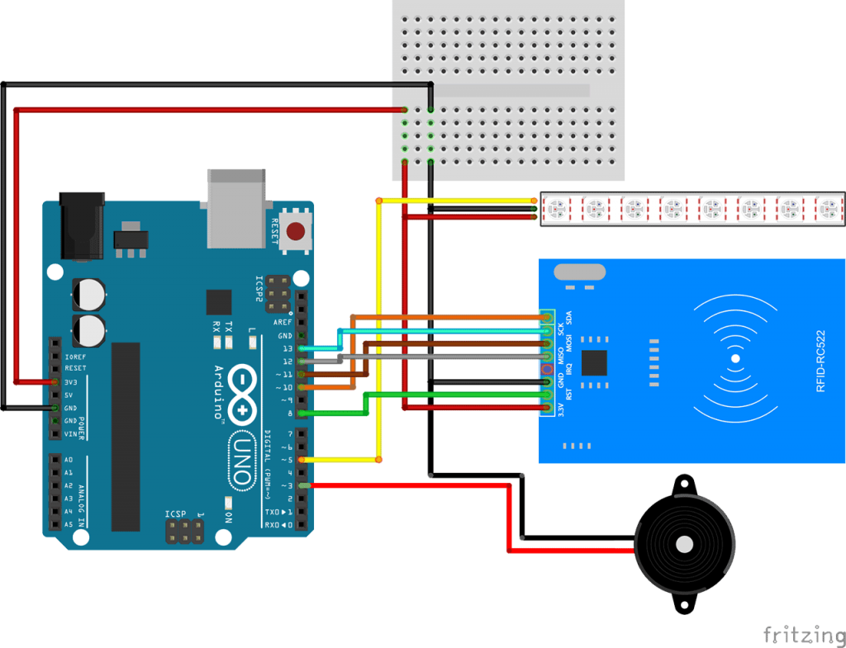

Slide 7
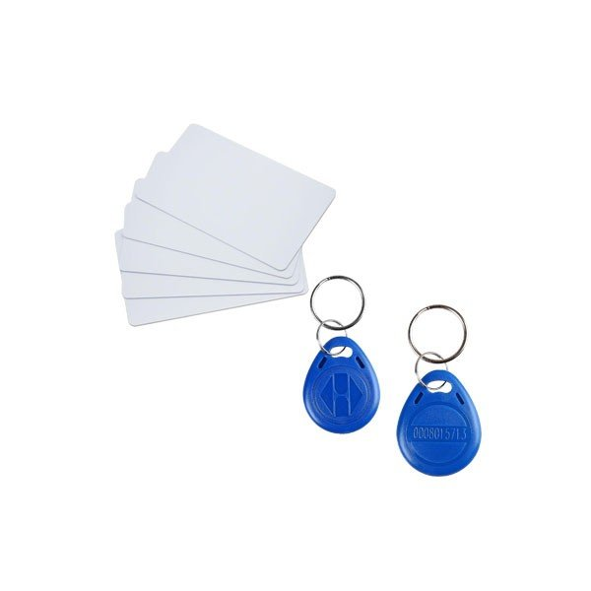
HARDWARE
ARDUINO UNO
RFID Reader
RFID Tag
LED
Speaker
A laptop

Slide 8
SOFTWARE SECTION
Parallax Data Acquisition Tool
Microsoft Excel
Arduino IDE

Slide 9
BLOCK DIAGRAM
Computer with Microsoft Excel &
PLX-DAQ
Arduino
Uno
RFID Tag
RFID Reader

Slide 10
DESCRIPTION OF BLOCK DIAGRAM
A laptop is connected to the Arduino Uno using the USB cable.
The RFID reader is connected to Arduino Uno in specific order that is standard for the MFRC522 library used in the code.
RFID reader detects the RFID tag, If the tag is in the radio frequency range of the RFID reader.
Using PLX-DAQ tool we directly get the details of the Tag owner in the excel sheet.

Slide 11
Working of the model
A computer installed with Microsoft windows excel sheet and PLX-DAQ software is connected to Arduino UNO which in turn connected to RFID card reader.
This RFID card reader produces a radio frequency of certain range.
When a UID (Unique Identifier) card comes into the radio frequency range of RFID card reader, UID card gets detected.
Arduino UNO sends the detected card details to the spreadsheet using the PLX-DAQ tool.

Slide 12
FUTURE scope
If we talk about future scopes then it depends upon how innovative one could be to enhance the use of this project. But for us this project is very useful for future uses:
Uses in ATM machines.
Use in car lock keys and engine start by placing the card in front of reader.
Make things environment friendly.
Gaming zone and many more future uses.

Slide 13
Advantages
The RFID based security and attendance system is more secure and fast responded as compared to the other system like biometric.
The main advantage of the RFID system is contact-less and works on non-line-of-sight. Tag works in any environmental condition.
By using the Arduino platform system becomes more faster in response and while burning the code it is just like plug and play device.
User can change the application accordingly by using Arduino.
It is very easy to use and very accurate also.

Slide 14
conclusion
Updating the old school type of attendance marking takes us a step ahead to the modernization and also using of electronic embedded system makes a man’s work a lot easier.
this project can be very useful for implementing the real time application for recording the attendance and tracking system as well as providing the security benefits.

Slide 15
references
ARDUINO UNO: https://store.arduino.cc/usa/arduino-uno-rev3
PLX-DAQ: https://www.parallax.com/downloads/plx-daq
ARDUINO IDE: https://www.arduino.cc/en/main/software
RFID-RC522 interface with Arduino : https://lastminuteengineers.com/how-rfid-works-rc522-arduino-tutorial/

Slide 16
Cost estimate
S.NO | COMPONENT/MODULE | QUANTITY | COST PER MODULE/COMPONENT | TOTAL COST (in rupees)
1 | Arduino Uno | 1 | 300 | 300
2 | RFID card reader (MFRC522) | 1 | 150 | 150
3 | RFID tags | 5 | 20 | 100
4 | LED, Speaker and etc | - | 100 | 100
TOTAL EXPENDITURE (in rupees) |  |  |  | 650

Slide 17
CO VS PO , CO VS PEO , CO VS PSO MAPPING
 | PE01 | PEO2 | PEO3 | PO1 | PO2 | PO3 | PO4 | PO5 | PO6 | PO7 | PO8 | PO9 | PO10 | PO11 | PO12 | PSO1 | PSO2 | PSO3
CO1
CO2
CO3
CO4
CO5

